Slide 1
System and Network Administration
TinyNet Essentials

Slide 2
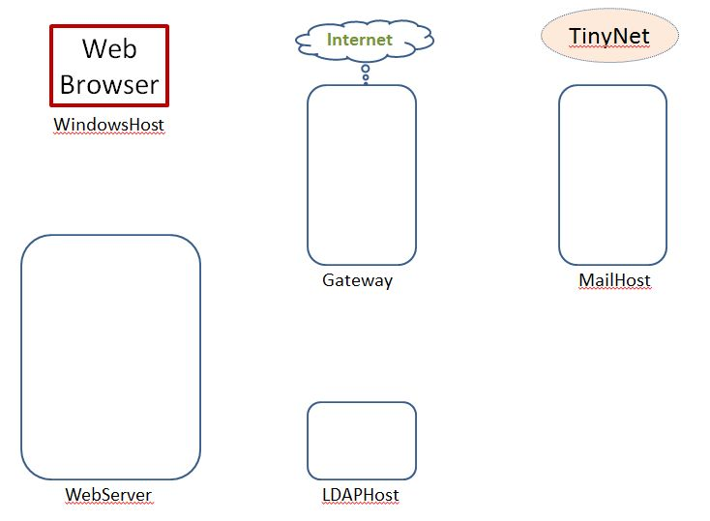
Getting Started
TinyNet
Comes in two parts
Base.iso (base image)
Config.iso (configuration and applications)
Create a virtual machine
Partition the disk
Create a filesystem
Copy the OS
Install the bootloader
Configure common services
Clone!
After installing VirtualBox, create VMs!
www.my-tiny.net

Slide 3
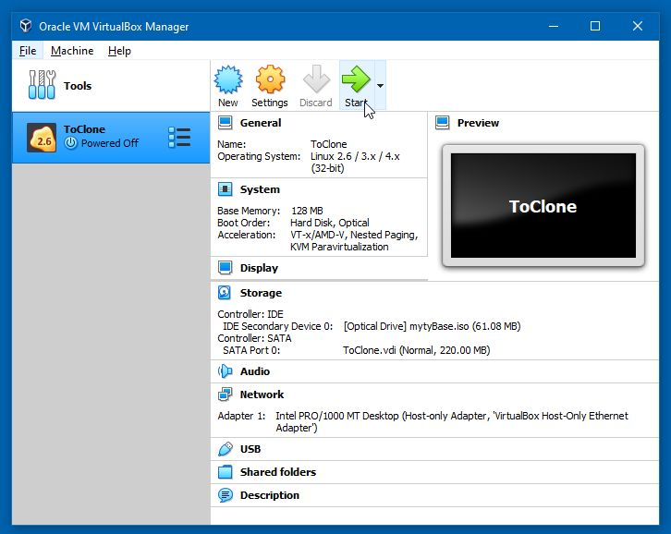

Slide 4


Slide 5
First Things First
There are a few more steps to configure common services
/etc/rc.d/rc.sshd - Set the execute bits for everyone
/var/run - Set the sticky bit and set rwx for everyone
/usr/local/sbin/banana - Symlink as /etc/rc.d/rc.monkey
/etc/rc.d/rc.xinetd - Set the execute bits and Symlink as /etc/rc.d/rc.inetd
/etc/xinetd.d/telnet - Edit: Enable=yes Only From the localhost address
Prepare the webserver logfile from the command line:
keyboard: touch /var/log/httpd.ERRORS
use [up-arrow] and edit;
chmod 664 /var/log/httpd.ERRORS
chown nobody:nobody /var/log/httpd.ERRORS
keyboard: ls -l /var/log
Once this is done, we are ready to clone!

Slide 6
Paths
/ root directory . here .. up one level
/tmp/foo absolute tmp/foo relative ../../foo
cd change directory mv move or rename
cd /etc
cd foo
cd ..
mv foo ofo rename
mv ofo /var/opt move
cd /var/opt/ofo
./myscript.sh execute a file stored here

Slide 7
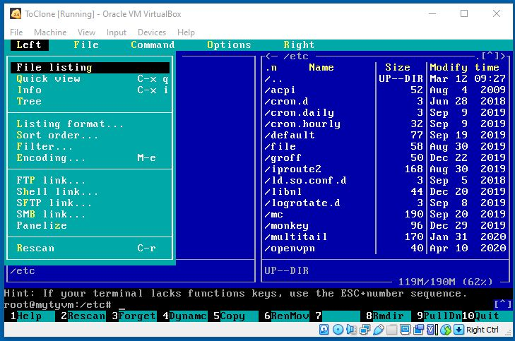
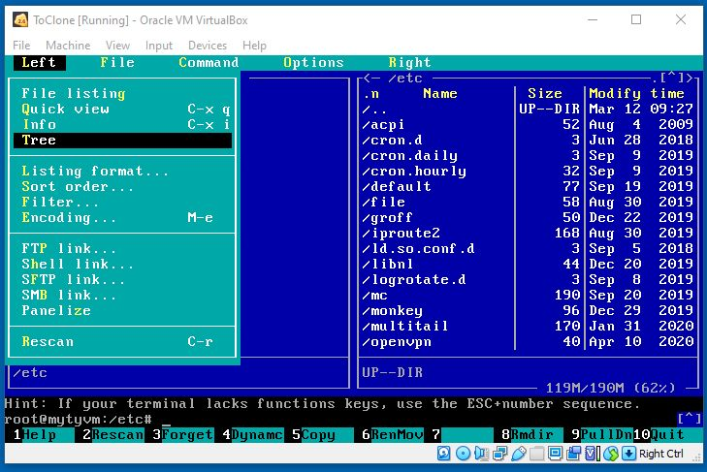
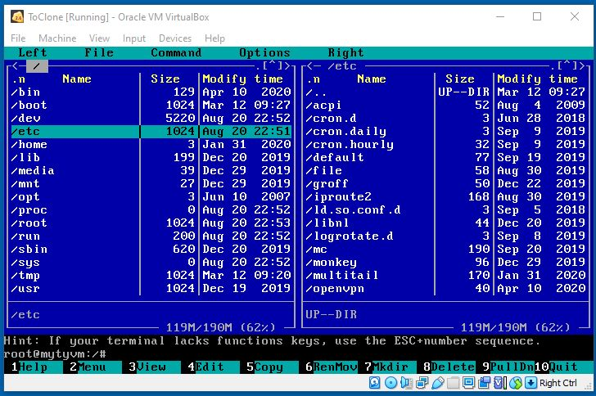
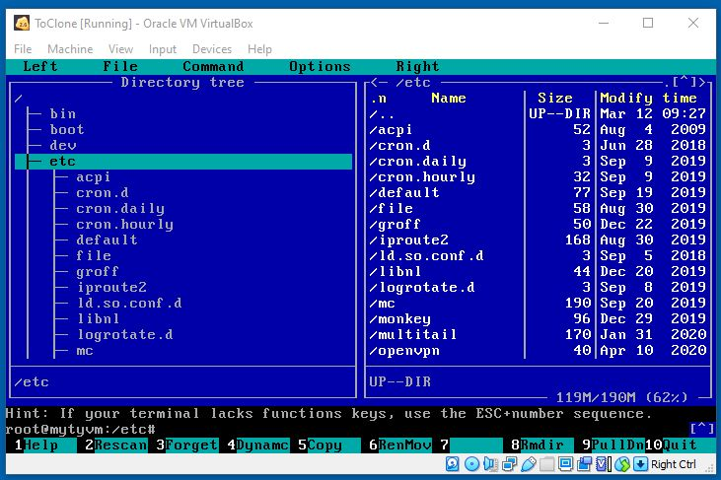
Press [F9] for the mc menu
Two directories
Tree and directory
Press [Tab] to switch sides

Slide 8
Symlink
Soft link or symbolic link (symlink): a small file that is a pointer to another file.
contains the path to the target file instead of a physical location on the hard disk; can point across partitions.
Note that removing the target file for a symbolic link makes the link useless.
Windows: shortcut (right click : file : properties)
used to create a new name to satisfy dependencies
a program that expects a file to be in another location
Symbolic links can generally save a lot of work

Slide 9
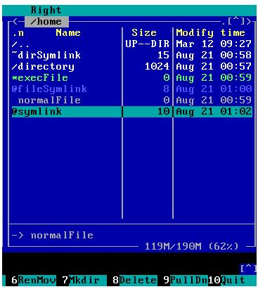
Up one Level
Curent Directory
Directory (Folder)
Executable File
C:\Users in Windows
is the equivalent of
/home in Linux
Symlink Target
Press [F9] for the mc menu

Slide 10
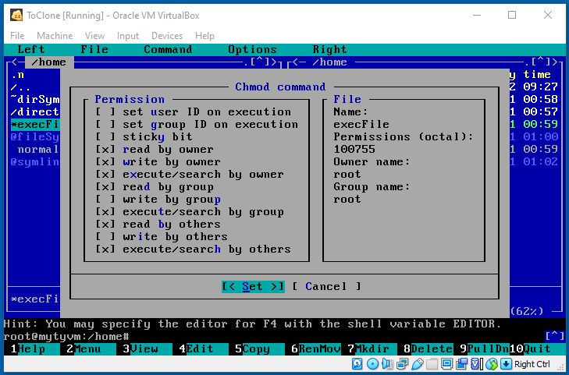
Linux Permissions
Not normally used
Numeric Representation:
Read = 4, Write = 2, Exec = 1
4 + 2 + 1 = 7
[Space] to turn on or off

Slide 11
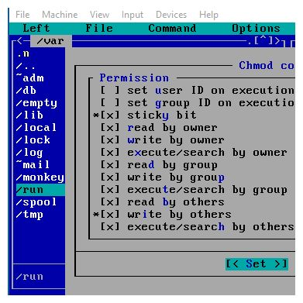
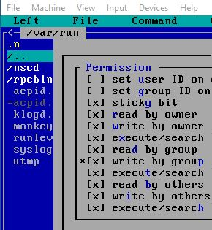


Special Directory Permissions
Sticky Bit (Directory Only):
Anyone can write a file
Only the owner can delete

Slide 12




Slide 13
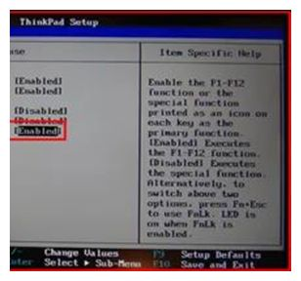
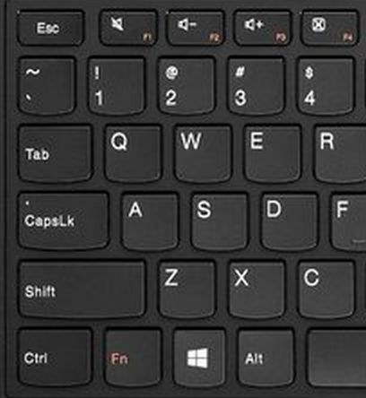
Dual-Purpose Fkeys
Hold the Fn Key to change what the Fkey does

Slide 14
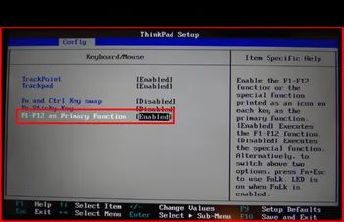
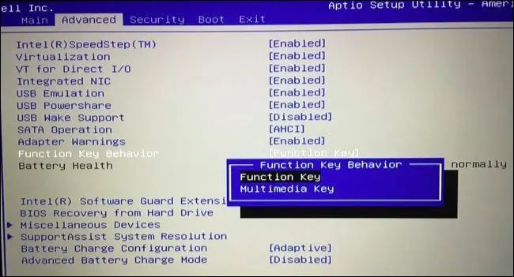
Dual-Purpose Fkeys
This is another one you might be able to change in the BIOS
Takes some exploring …

Slide 16
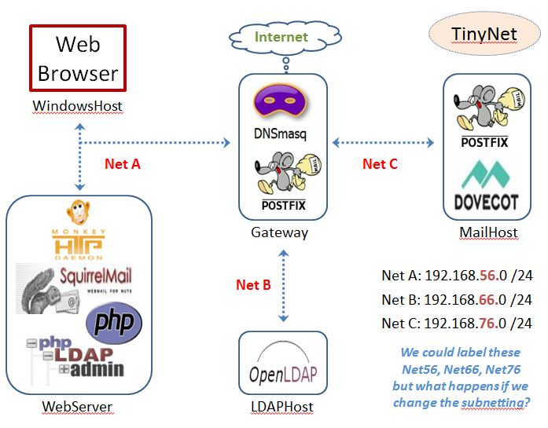
Gateway: One interface for each subnet
HOSTNAME
Is registered
With dnsmasq
Via DHCP
Matched to
Configured
cnames
Broadcast
Domain

Slide 17
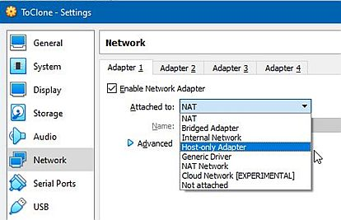
Virtualbox Network Interfaces

Slide 18
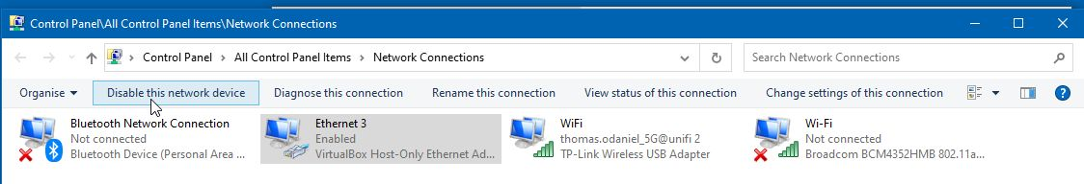
Virtualbox: Host-only interface
Host-only interface is used to create a network with the host and a set of virtual machines
Uses a new "loopback" interface on the host, which appears next to the existing network interfaces.
Problems with Host-Only networking can (sometimes) be solved by simply disabling the Windows Host-Only interface,
and then enabling it again

Slide 19
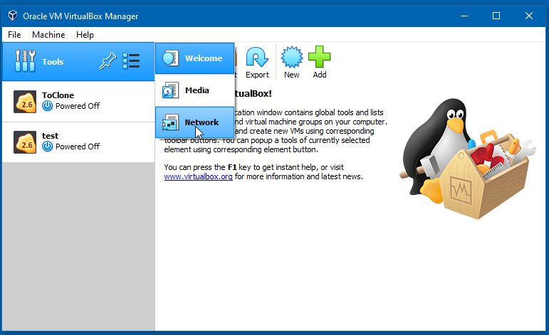
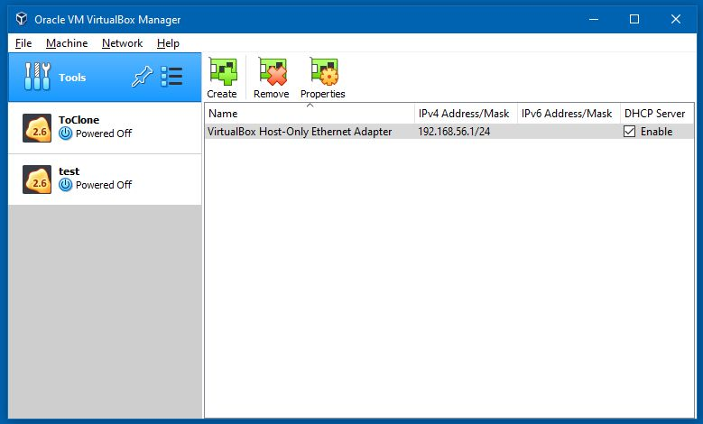


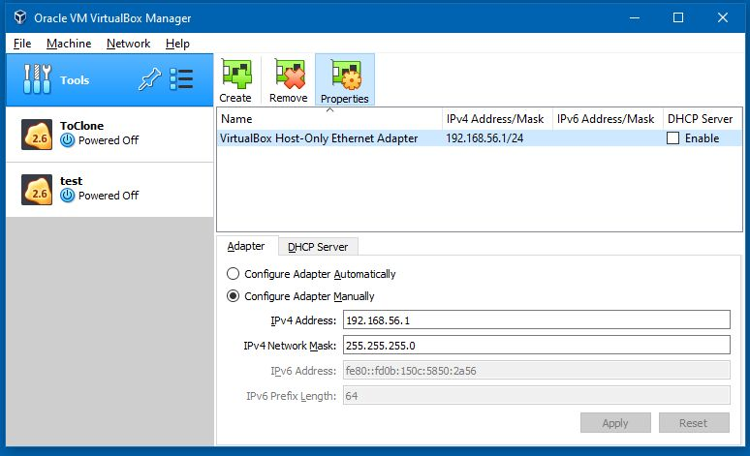
ALL VMs OFF
IP: 192.168.56.1 DHCP OFF
Exit Vbox after any change
BEWARE: Windows Update may change the IP, or destroy the adapter
If you create a new adapter, you need to update the Network interface settings for each VM with the new name

Slide 20
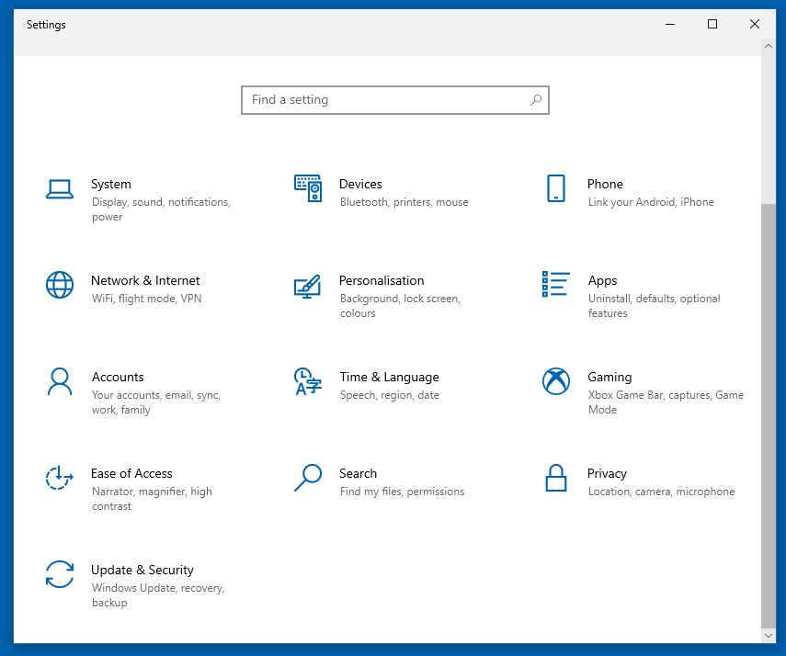
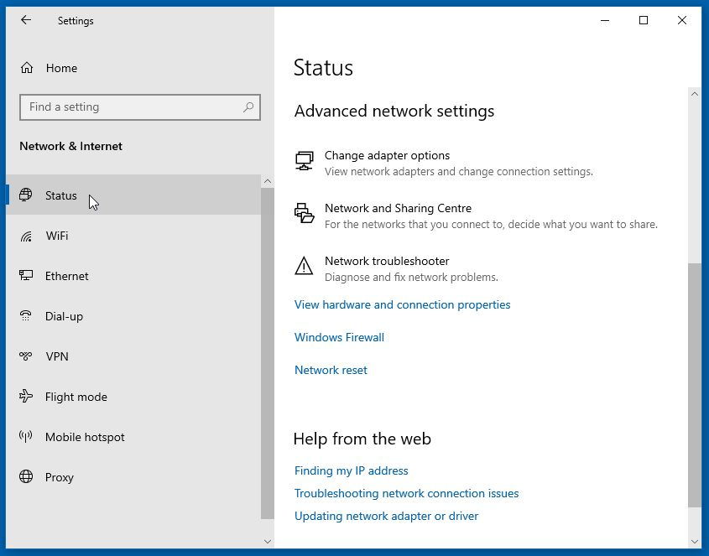
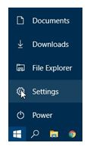
Network Interface in Windows
2
3
1
Accessing Properties
(Requires Administrator Privileges)

Slide 21
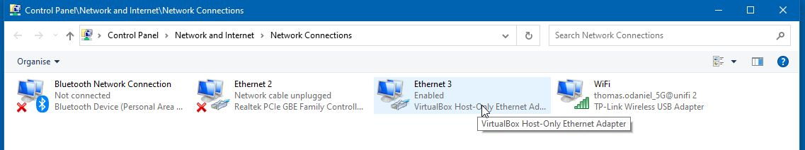
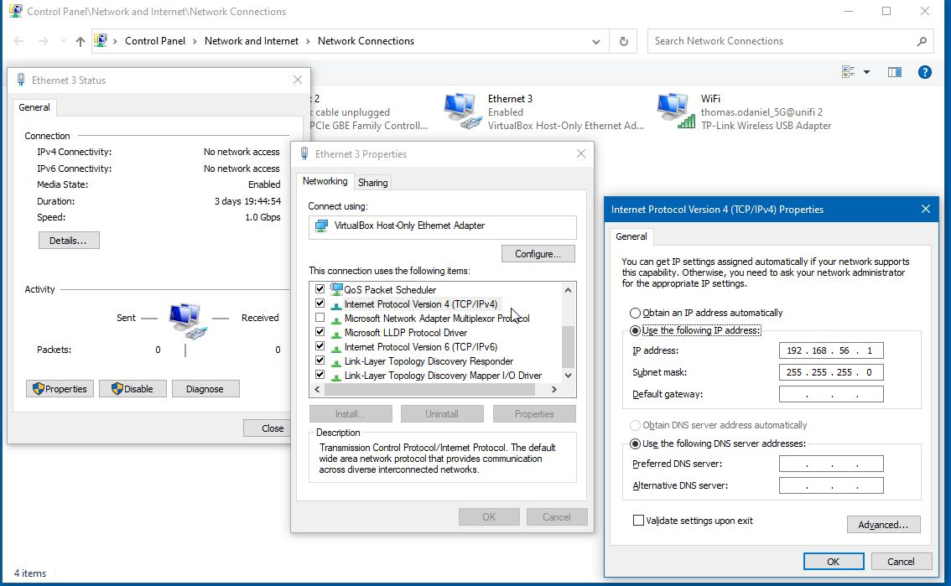
1
3
2

Slide 22
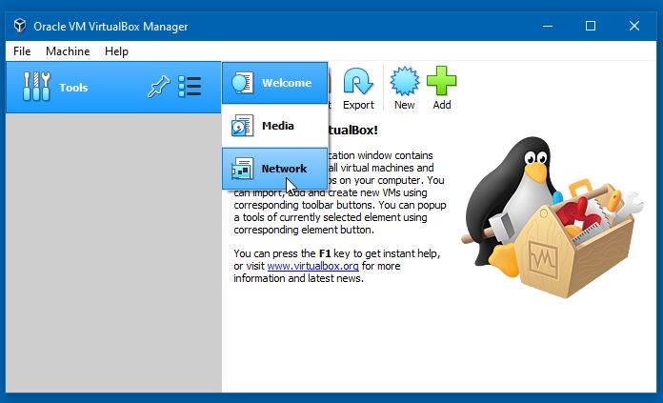
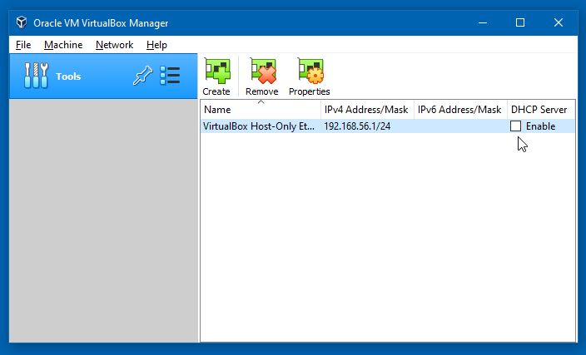
The First Thing to take care of is to Turn Off the VirtualBox internal DHCP server

Slide 23
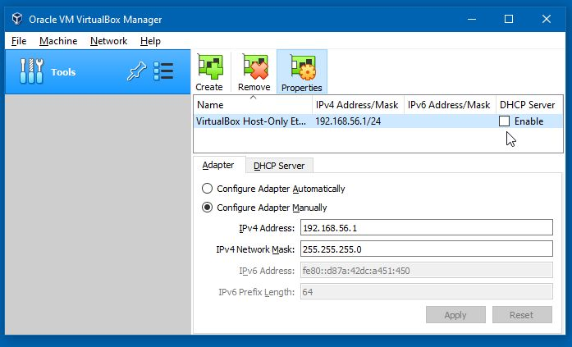
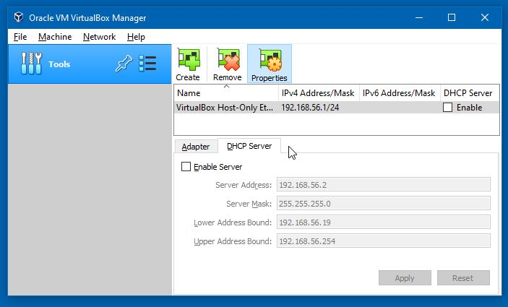
The Next Thing is to Check the IP Address is 192.168.56.1

Slide 24
Virtualbox: Bridged interface
VirtualBox connects to one of the installed network interfaces on the host to send and receive
The VM acts like it is physically connected to the network, but there is no new interface visible on the host system
VirtualBox asks your ISP for a new IP address for the VM (which will not be assigned if the network requires a separate login for every connection).
When the Bridged interface has its own IP address, it has full connectivity on the network, and can be contacted from anywhere.

Slide 25
Virtualbox: NAT interface
With a Network Address Translation (NAT) interface, the TCP and IP headers of network frames sent out by the VM are modified by the VirtualBox NAT engine, and passed on to the network using the host operating system.
Other computers on the network receive, and reply to, messages with an IP address that belongs to an interface on the host.
VirtualBox listens for replies, and modifies them to pass back to the VM across an internal connection.
The VirtualBox NAT engine assigns the internal IP address, so other computers on the network cannot contact the VM directly: the VM can only recieve replies to requests it sends to them.

Slide 26
Virtualbox: other interface types
Internal interface: Used to create a network of VMs only, without connections to the host or to the outside world.
NAT Network interface: a type of internal network that allows outbound connections as well as connections between VMs.
This usually requires requires command line configration with the vboxmanage utility, because setting up port forwarding is required to run a server this way:
See Section 6.3.1, “Configuring Port Forwarding with NAT”, Section 6.4, “Network Address Translation Service”, and Section 9.8, "Fine Tuning the Oracle VM VirtualBox NAT Engine" in the documentation at virtualbox.org

